Slide 1
EU5332
Topics for Laboratories
Emma Kileel, REPRIEVE Clinical Coordinating Center
Andrew Lohrum, LDMS

Slide 2
Shipping Specimens
Ship to the repository (BRI) per your assigned schedule, schedule is located on the FSTRF Portal, Lab Resources Folder
Sites will ship every September and March
Review Shipment of Specimens to BRI prior to shipping
Lab and shipping related documents are located in the Lab Resources Folder on the FSTRF Portal.

Slide 3
Preparing for shipment

Slide 4
Preparing for Shipment
Read or review EU5332 Shipment of Specimens to BRI (on FSTRF portal)
Check shipping schedule on FSTRF portal to ensure you are shipping at the designated time
Check to make sure you have all required supplies
Specimens in storage boxes accurately recorded in LDMS
Shippers: STP320
Medium STP-152: 250mL Absorbent strips
STP-710 Disposable 2-Part Secondary Pressure Vessel
Shipments should be sent on Mondays, Tuesdays, or Wednesdays only to assure weekday delivery
BRI is closed on weekends and U.S. holidays and unable to receive the specimens
If a site/lab is unable to ship during its designated week, it must make arrangements with BRI to ship on another date (email: brireporsitory@afbr-bri.com)
Shipping supplies will be provided by World Courier

Slide 5
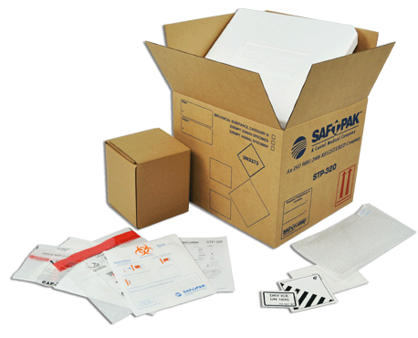
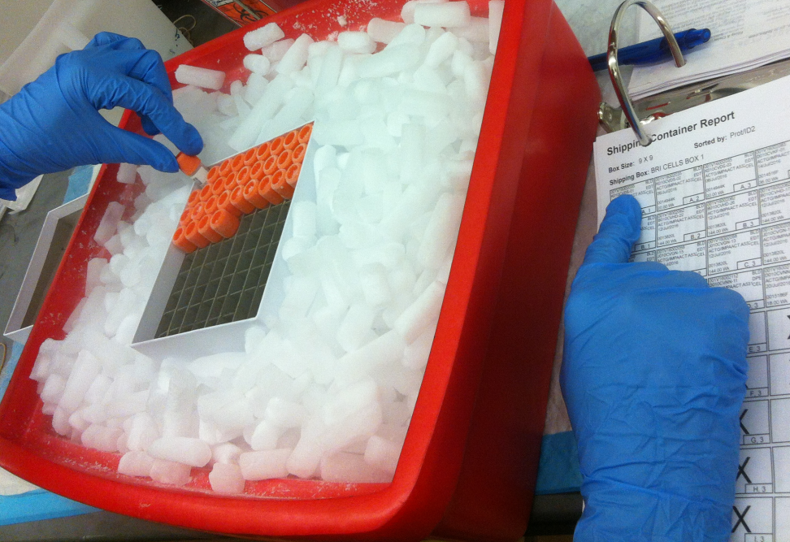
Check to make sure you have all required supplies
All samples will be stored in REPRIEVE EU5332 freezer boxes:
✔
Label all boxes as above!
Generate LDMS Shipping Manifest document to include in shipment
QA/QC of samples
Keep the “Chain of Cold” at all times.

Slide 6
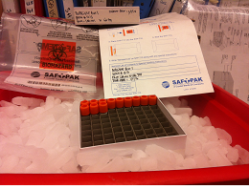
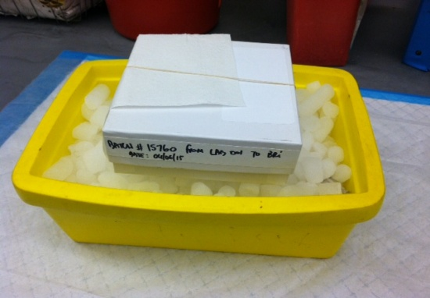
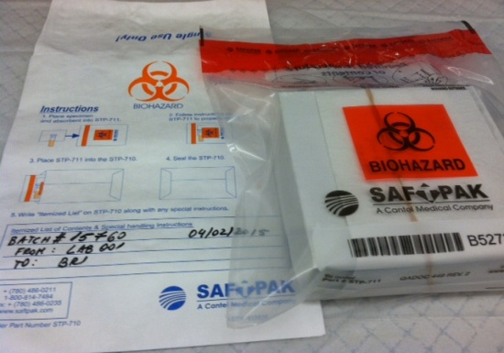
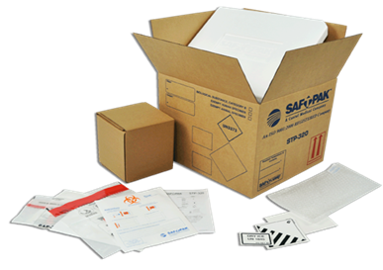
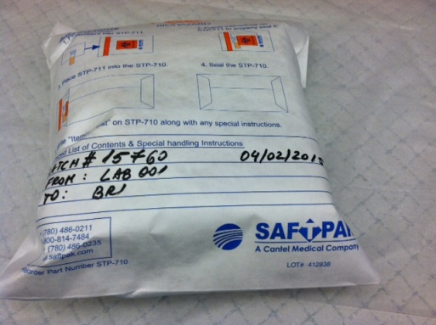
QA/QC and Preparation of Samples Complete
Wrap the labelled freezer box with absorbent strip (i.e. STP-152)
Insert freezer box in leak proof bag and Tyvek envelope (i.e. STP-730)
Keep the “Chain of Cold” at all times.
Next Slide
Pack shipment using shipping supplies provided by WC, STP320System
Record on Tyvek envelope: the LDMS batch number, From: [your lab number], To BRI, and the shipping date

Slide 7
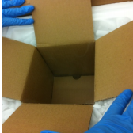
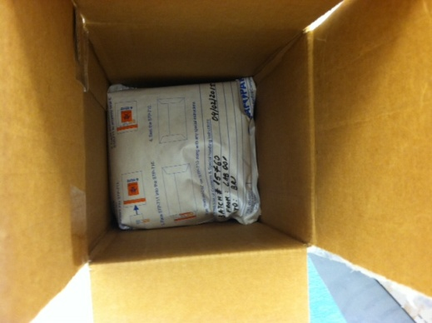
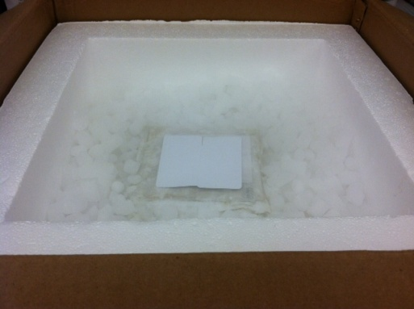
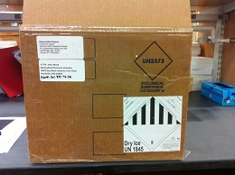
Place dry ice in Styrofoam box to cool down the inner box (i.e. STP-111)
Insert the storage box into the inner box (i.e. STP-111)
Close the inner box and fill the shipper with dry ice.
Keep the “Chain of Cold” at all times.
Ensure all labels are properly in place
In the pouch:
LDMS-generated shipping manifest
LDMS-generated box map
World Courier waybill
Email LDMS shipping file to BRI

Slide 8
You’re almost ready to ship! But first…
Review instructions for overnight shipments
Complete the Ambient/Refrigerated/Frozen Specimen Shipment Notice Form located on FSTRF Portal
Complete International Shipment Checklist
All forms are located on the Frontier Science Portal under the ‘Lab Resources’ tab

Slide 9
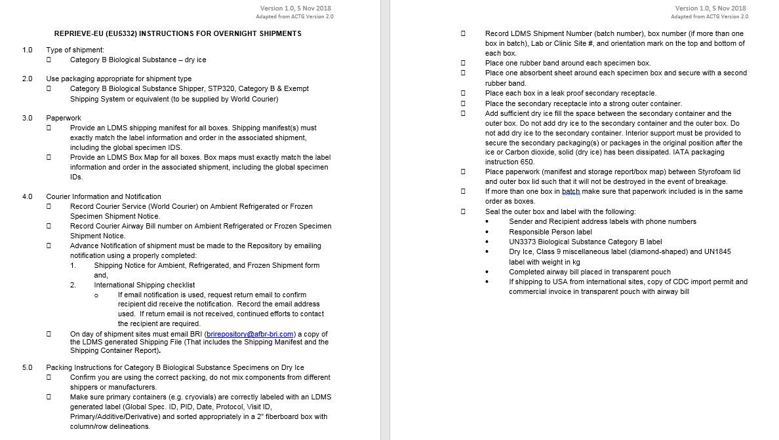
✓
Review Instructions for Overnight Shipments document located on FSTRF Portal

Slide 10
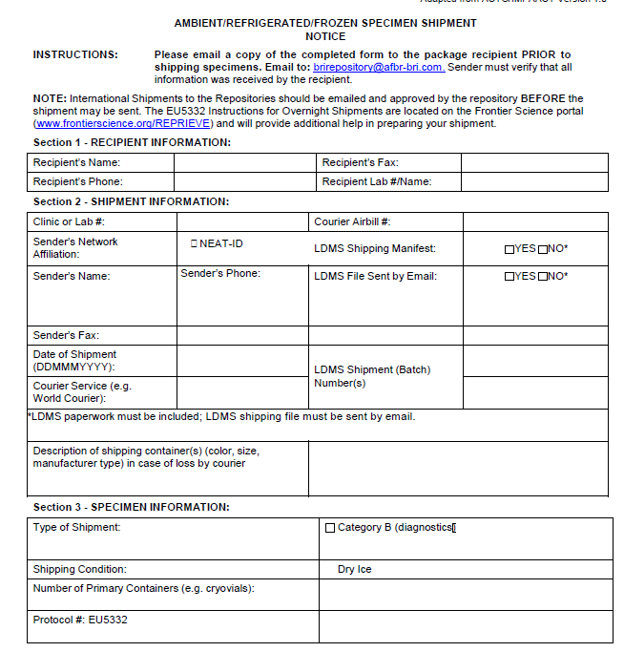
✓
Complete the Ambient/Refrigerated/Frozen Specimen Shipment Notice Form
John Ward
(P) 301-881-7636
(F) 301-770-9811
999/Biomedical Research Institute (BRI)
World Courier
✓

Slide 11
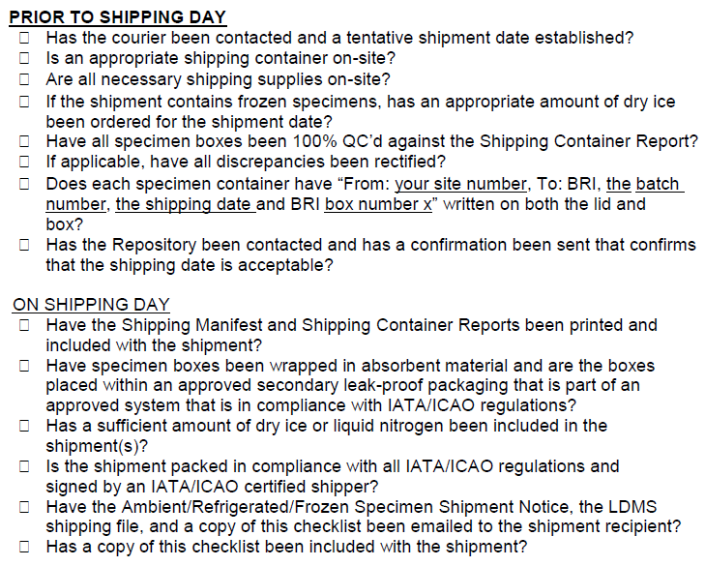
✓
Complete International Shipping Checklist

Slide 12
Are you ready to ship?
✓
Review instructions for overnight shipments
Complete the Ambient/Refrigerated/Frozen Specimen Shipment Notice Form
Complete International Shipping Checklist
Notify BRI of incoming shipment
Include copy of Ambient/Refrigerated/Frozen Specimen Shipment Notice, the LDMS shipping file, and a copy of the International Shipping Checklist in notification email to BRI
✓
✓

Slide 13
Post shipment

Slide 14
BRI receives shipment
BRI performs QC on shipment received
BRI will send Shipment Evaluation Documentation to site lab and performance evaluation committee.
If no problem noted, site responsibilities complete
Problem noted on Shipment Evaluation Documentation
Contact CRA’s Alba Sierto or Nuria Navarro
Site/Lab must respond to BRI within 1 week

Slide 15
Resources
REPRIEVE-EU Core Team Email: reprieve.coreeu5332@fstrf.org
WebLDMS: ldmshelp@fstrf.org
World Courier: opsmad@worldcourier.es
Biomedical Research Institute (BRI): brirepository@afbr-bri.com

Slide 16
EU5332 Site Shipping Schedule
REPRIEVE-EU (EU5332) Site Specific Schedule, rev 04 Aug 2019
Site Name | Site ID | Lab ID | Week of Month to Ship (Week 1 is defined as the first week of the month that includes a Monday) | Month to Ship
Hospital Clinic de Barcelona | 50 | 678 | Week 1 | Mar, Sept
Hospital Universitario La Paz | 51 | 679 | Week 1 | Mar, Sept
German Trias y Pujol University Hospital | 52 |  | Week 1 | Mar, Sept
Hospital Universitario Ramón y Cajal | 53 | 680 | Week 1 | Mar, Sept
Hospital Universitario de Bellvitge | 54 | 681 | Week 2 | Mar, Sept
Hospital General Universitario de Alicante | 56 |  | Week 2 | Mar, Sept
Hospital General Universitario De Elche | 57 | 688 | Week 2 | Mar, Sept
HGU Gregorio Marañon | 58 | 682 | Week 3 | Mar, Sept
Hospital 12 de Octubre | 59 | 683 | Week 3 | Mar, Sept
Hospital San Carlos | 60 | 684 | Week 3 | Mar, Sept
Hospital Universitario Valle de Hebrón | 61 | 685 | Week 3 | Mar, Sept
Hospital Universitario Basurto | 63 | 686 | Week 4 | Mar, Sept
Hospital Virgen de la Victoria | 64 | 687 | Week 4 | Mar, Sept

Slide 17
Questions?

