Slide 1
LDMS Validation and Audit Readiness
Howard Gutzman
LDMS Program Director
February 2025

Slide 2
Software Validation
Software validation checks that the software product satisfies or fits it’s intended use
The Vendor performs validation as part of the software development life cycle
The End-User performs validation to confirm the software functions as intended within the end user's environment
Each requires significant documentation, recording the process, results, and evaluation of the software
Notes:
Underline vendor and end-user

Slide 3
21 CFR Part 11
§11.10a Validation of systems to ensure accuracy, reliability, consistent intended performance, and the ability to discern invalid or altered records

Slide 4
FDA Guidance
Advises:
Testing at the user site is an essential part of software validation
Testing should take place at a user's site with the actual hardware and software that will be part of the installed system configuration
Testing is accomplished through either actual or simulated use of the software being tested within the context in which it is intended to function
User site testing should follow a pre-defined written plan with a formal summary of testing and a record of formal acceptance. Documented evidence of all testing procedures, test input data, and test results should be retained
General Principles of Software Validation; Final Guidance for Industry and FDA Staff (FDA, Center for Devices and Radiological Health, Center for Biologics Evaluation and Research, 2002) §5.2.6

Slide 5
Standard Operating Procedures (SOP’s)
Some examples of SOP’s your lab should have in place pertaining to the LDMS
Alternative recording methods (in the case of system unavailability)
User training
Access and User accounts (System security measures)
System operating/user manual [available on LDMS website]
Validation and functionality testing
Guidance for Industry; Computerized Systems Used in Clinical Investigations (FDA, Center for Devices and Radiological Health, Office of the Commissioner, 2007) Appendix A
Notes:
Setup/installation – available on FSTRF Portal/LDMS website

Slide 6
End-User Validation Documentation

Slide 7
End-User Validation Documentation
This process is independent of the developer
The documents need to be developed and maintained by each lab
If requested, Frontier Science will provide the validation documentation pertaining to the development of the LDMS
We have created sample SOPs and validation templates for our labs as tools to create their own suite of documentation (LDMS website)
Notes:
3rd bullet – pertaining to its software development lifecycle, including developer testing

Slide 8
Validation and Functionality Testing
Documents the procedures for performing and documenting the validation of the software program within the end user's environment
Create a Validation Team to perform tasks
Perform a Risk Assessment to determine the steps and documentation required
Content of validation documents is described in templates
Validation Plan
User Specifications/Requirements
Installation Qualification (not required for web LDMS)
Testing Plan
Testing Report
Validation Report
Validation documents are stored as “Essential Documents”

Slide 9
Validation Templates
Validation Plan
User Specification and Requirements
Installation Qualification
  Validation Team members and responsibilities
  Initial risk assessment
  List of specific validation activities
  List of proposed deliverables
  List all of the users’ specifications, requirements, and expectations for the system
  Based on inputs from anticipated users, IT, Validation Team
  Can be based on a RFP
  Installation and configuration should follow all vendor guidelines
  Document all configuration settings
  Create back-up procedures
  Not required for LDMS

Slide 10
Validation Templates, cont.
Testing Plan
Testing Report
Validation Report
  Test Cases
  Expected Results
  Test cases should cover multiple scenarios to insure program functions as intended
  Test Cases
  Actual Results
  Resolutions (if applicable)
  Evaluation
  Details successful validation of the program

Slide 11
Test Cases
Requires careful test planning, the definition of expected test results, and the recording of all test outputs
Acceptance Test Execution
  Test case and its expected results
Test Results Evaluation
  Does the test pass or fail
Error Evaluation/Resolution
  Resolutions for any failed tests
Final Test Report
  Records test cases, actual results, and any resolutions
Adapted from: General Principles of Software Validation; Final Guidance for Industry and FDA Staff (FDA, Center for Devices and Radiological Health, Center for Biologics Evaluation and Research, 2002) §5.2.6

Slide 12
Test Case – Example 1
After adding a new processing date/time in the Specimen Management module, go to the Reports module and run the Specimen Processing report. Use search criteria that will pull the specimen into the report (ie. PID and Specimen Date or Received Date)
Expected Result: The processing date and time will be present in the report and match the record in Specimen Management

Slide 13
Test Case – Example 2
After importing a LDMS shipping file, create a shipment manifest in the View Shipment tab. Compare this document to the one provided by the sending lab.
Expected Result: Contents of each document match

Slide 14
Reports for Audits available in the LDMS

Slide 15
Reports
Specimen Log Report
  This report provides the user with a list of all of the specimens that the Lab has logged into their LDMS. The report also provides the primary and associated aliquot information for a given specimen.
Storage Detail Report
  This report provides a detailed summary of the exact specimens and location of all the aliquots that are stored in a container held within a lab’s storage structure hierarchy.
User Permissions
  This report provides the user with a summary of all the users in the LDMS and lists their current permissions within the LDMS.

Slide 16
Transaction Log
21 CFR §11.10e - Use of secure, computer-generated, time-stamped audit trails to independently record the date and time of operator entries
This log is a historical record of all transactions performed by users in your LDMS database
The log is located in the Reports module: Admin category
Search criteria can be used to limit the report by date range and/or user
Generate as a CSV file in order to search the contents in Excel

Slide 17
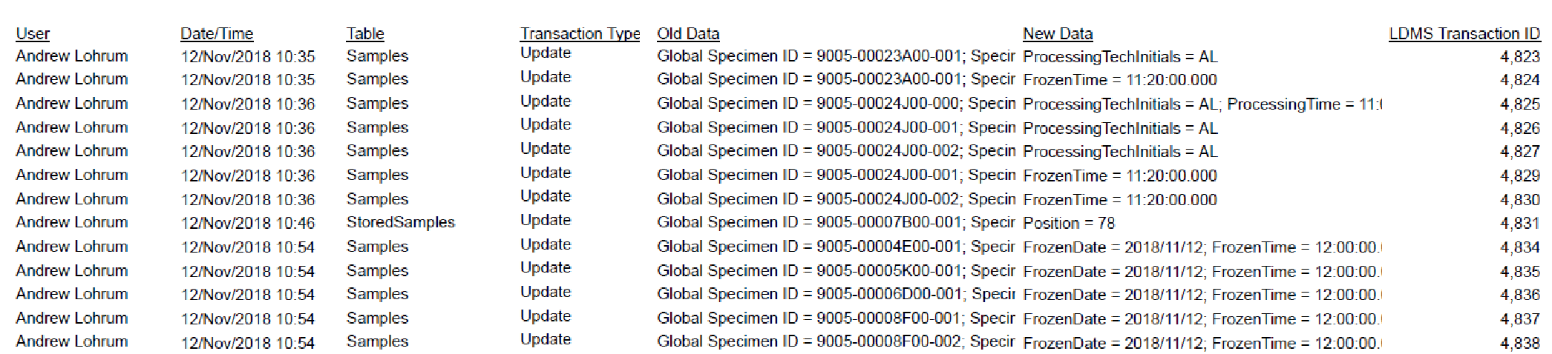
Transaction Log, cont.
In the example above, we see the user name, transaction type, and affected data
In the first line, the report records that the Processing Tech initials were updated to “AL” for 9005-00023A00-001
The LDMS Transaction ID is a unique serial number for each transaction in the database

Slide 18
User Event Report
The report is located in the Reports module: Admin category
Shares all events that occurred during the specified filter criteria
    Filter criteria can be used to limit the report by event date, event type, login ID, module, or transaction ID
Generate as a CSV file in order to search the contents in Excel

Slide 19
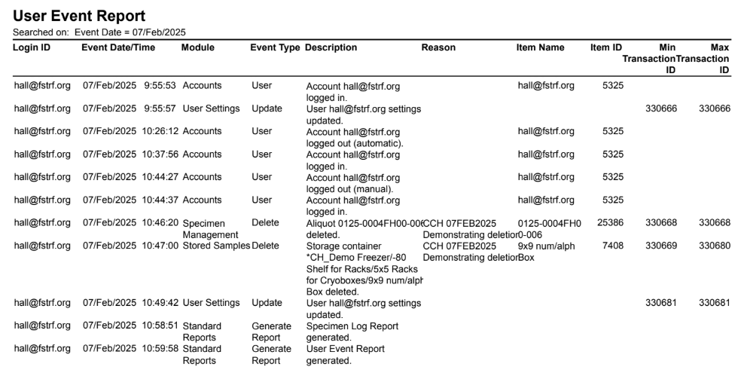
User Event Report, cont.
On the report we can see event type listed, along with all details related to the event such as who was logged in, when it occurred, a description of the event, and a reason for the event

Slide 20
Custom Report Builder
The Custom Report Builder module allow users to export data from their LDMS by creating custom data reports
Users can construct reports from a large variety of data fields in Specimen, Storage, and Shipping categories
Searches are used to refine the information included in the report
Reports can be generated as a CSV, tab-delimited, or XML file

Slide 21
Information for Audits on LDMS website

Slide 22
Requesting documents for validation
On the LDMS website, select: Resources > Validation
Complete the form and submit
Frontier Science will follow up with an access code to download your documentation packet
Frontier’s software development and developer testing validation documentation is readily available for each current version of LDMS
The end-user documents provided are for guidance purposes only, completed documents must be in place well in advance of an audit
Notes:
5th bullet – rewrite to say FSTRF’s software development and developer testing validation documentation is readily available for each version of LDMS

Slide 23
Resources and Documentation
There are numerous resources and documents available on the LDMS website that could be useful when preparing for an audit.
  User Manual
  Inspection Readiness & Generating Reports document
  LDMS Validation and Audit Readiness Slides

Slide 24
Inspection Readiness & Generating Reports Document
There are several reports that will support inquiries that may occur during an audit or inspection:
  Specimen Processing Report
  Specimen Log Report
  Storage Detail Report
  Shipped Specimen Report Detail and Summary
  User Permissions Report
  Transaction Log Report
  User Event Report
Inspection Readiness & Generating Reports document provides descriptions of these reports and instructions for how to generate them in both Web and Windows versions of LDMS

Slide 25
Contact Us
If you are in the middle of an audit or if you know an audit is scheduled we are your resource.
Phone: (716) 834-0900 x7311
Email: ldmshelp@frontierscience.org
ldmsinfo@frontierscience.org
Web: https://www.ldms.org/contact/
https://www.ldms.org/resources/validation/

